Slide 2
Build Code Lab Office 365 Development 1: Integrating Conversations with Skype and Office 365 Connectors
L723
Richard diZerega (@richdizz)
Simon Michael (@simon_mich)

Slide 3
Proctors
Proctors are here to help you!
Raise your hand if you need any assistance
Andrew Coates DX
David Newman Skype
Doug Perkes DX
Pretish Abraham Outlook
Simeon Duong Outlook
Srividhya Chandrasekaran Skype

Slide 4
Office 365 Lab Modules
1
Mobile Development and the Microsoft Graph
2
Web Development and the Microsoft Graph
3
Building Office Add-ins with Web Development
3
Integrating Conversations with Skype and Office 365 Connectors
Notes:
“As a follow-on to this lab, we also have the Azure IoT lab. In that, you’ll learn how to use the Raspberry Pi to send sensor data to IoT Hub and process it using other Azure IoT services.
If you are interested in the underlying IO and other capabilities on devices like the Raspberry Pi, or want to explore more with Azure and devices, we also have the Open Hack in this same room, starting on Day 2.”

Slide 5
In this module…

Slide 6

Engage users through conversations
Your Apps & Services
Connect your service to conversations
Embed conversations in your app
Engage & Win users
Notes:
As you all saw in Satya's and Qi's keynote- Conversations are the new platform to engage with your users. A delightful user-experience now hinges on how well your service can connect and embed into your users conversations. Conversations are the most natural and rich way for users to engage with your service, and we'll see few examples of this later with rich-actions.

Slide 7
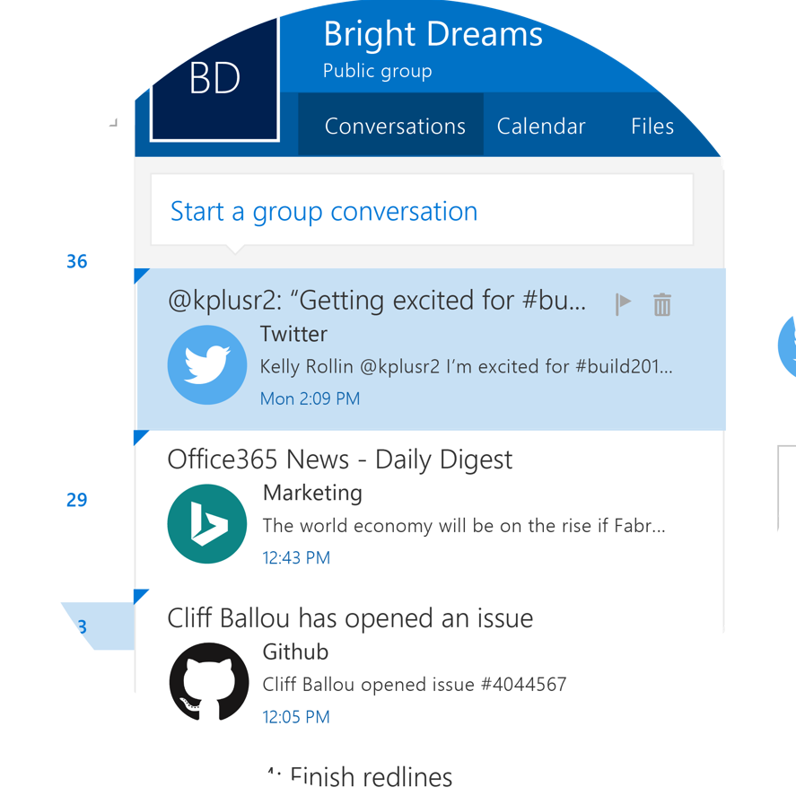
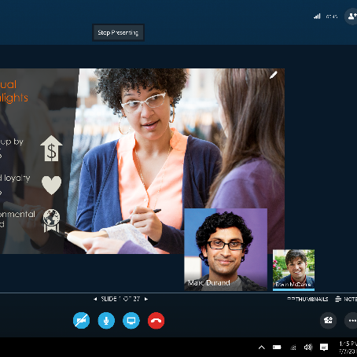
Engage users through conversations
Let your apps and services facilitate and participate in conversations
Office 365 Group Connectors
Skype Developer Platform SDKs
Notes:
With Office365 Connectors and the Skype Developer platform SDKs, we're ensuring that your service is seamlessly woven into the communication platform and that you can engage and participate with your users in the most natural place-- their conversations.

Slide 8
Getting setup…

Slide 9
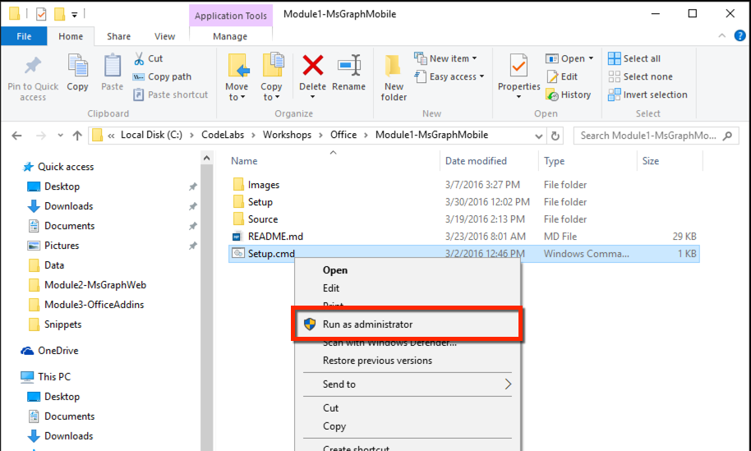
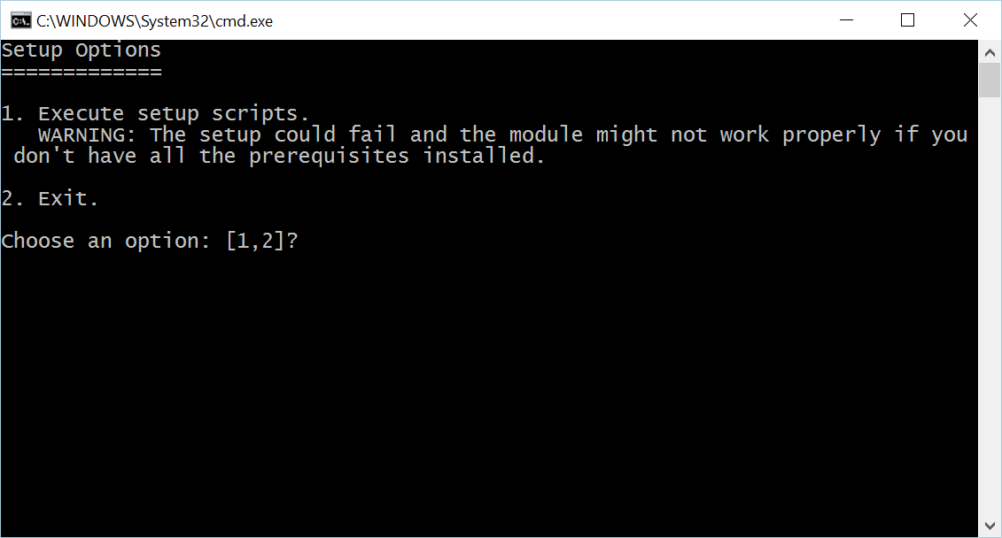
Install Code Snippets
Go to C:\Labs\CodeLabs-Office\Module4-O365ConnectorsAndSkype
Right-click on Setup.cmd, click on Run as administrator
Click Yes at the User Account Control prompt
Select option 1 in the command window

Slide 10
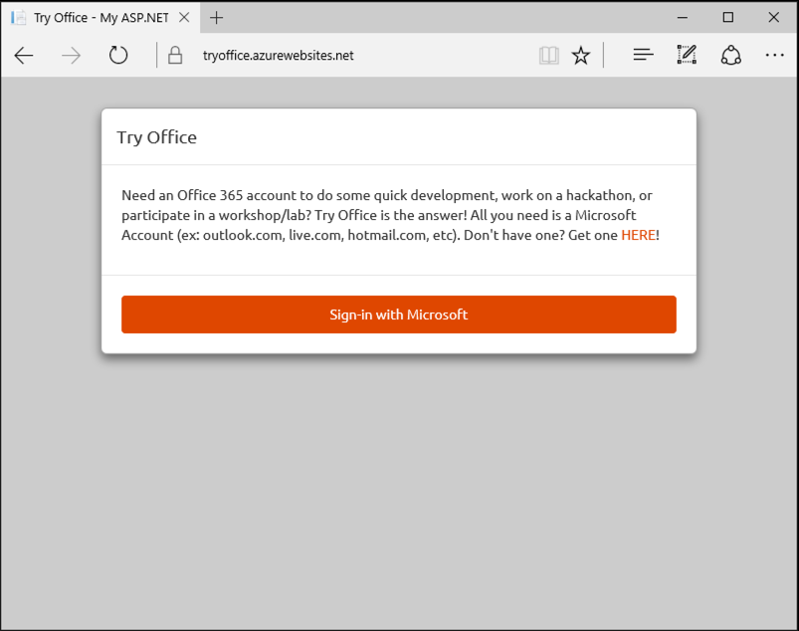
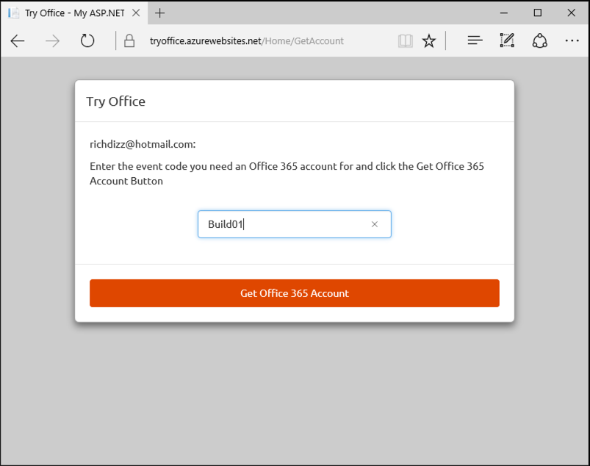
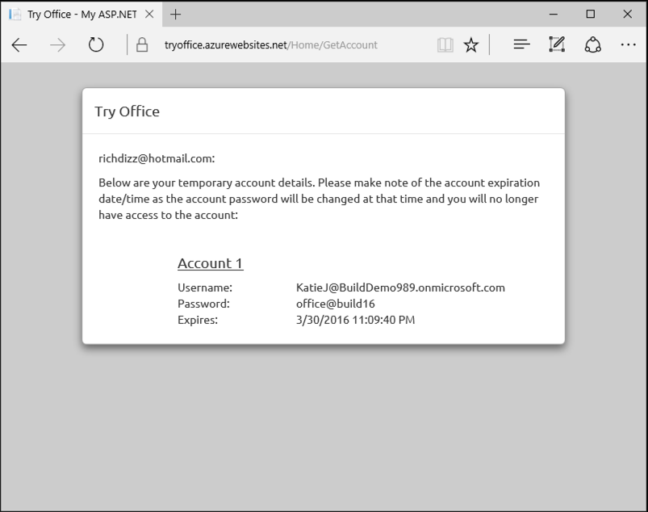
Get Office 365 Account
Navigate to https://aka.ms/tryo365dev and sign-in with a Microsoft Account (ex: Hotmail, Live, Outlook.com, etc)
Enter Event Code Build02 and click “Get Office 365 Account”
Capture the provided credential for use in the lab exercises
1
2
3

Slide 11
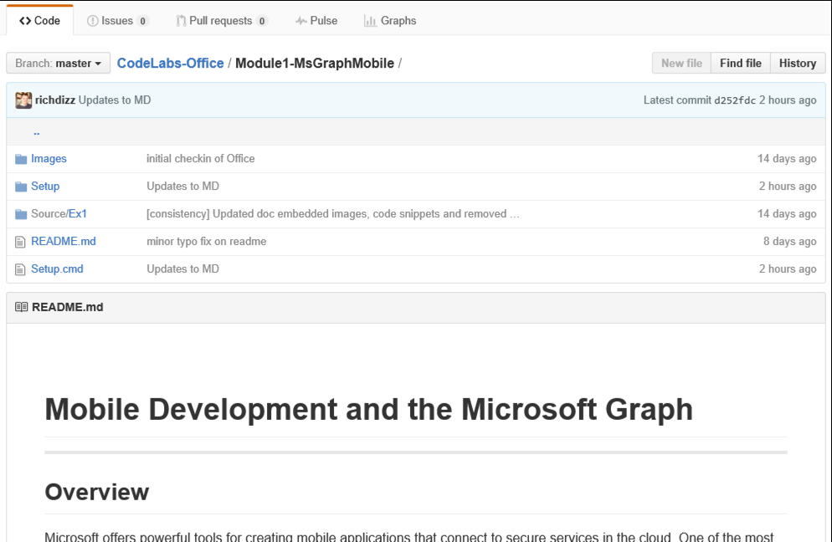
View lab manual
On your desktop, click the Office CodeLabs icon to open the browser at the Github repository for these labs: https://github.com/Microsoft-Build-2016/CodeLabs-Office
Click on the folder for the current module (Module4-O365ConnectorsAndSkype)
Scroll down for the README.md – this is your lab manual

Slide 12
Let’s start coding!!!

Slide 13
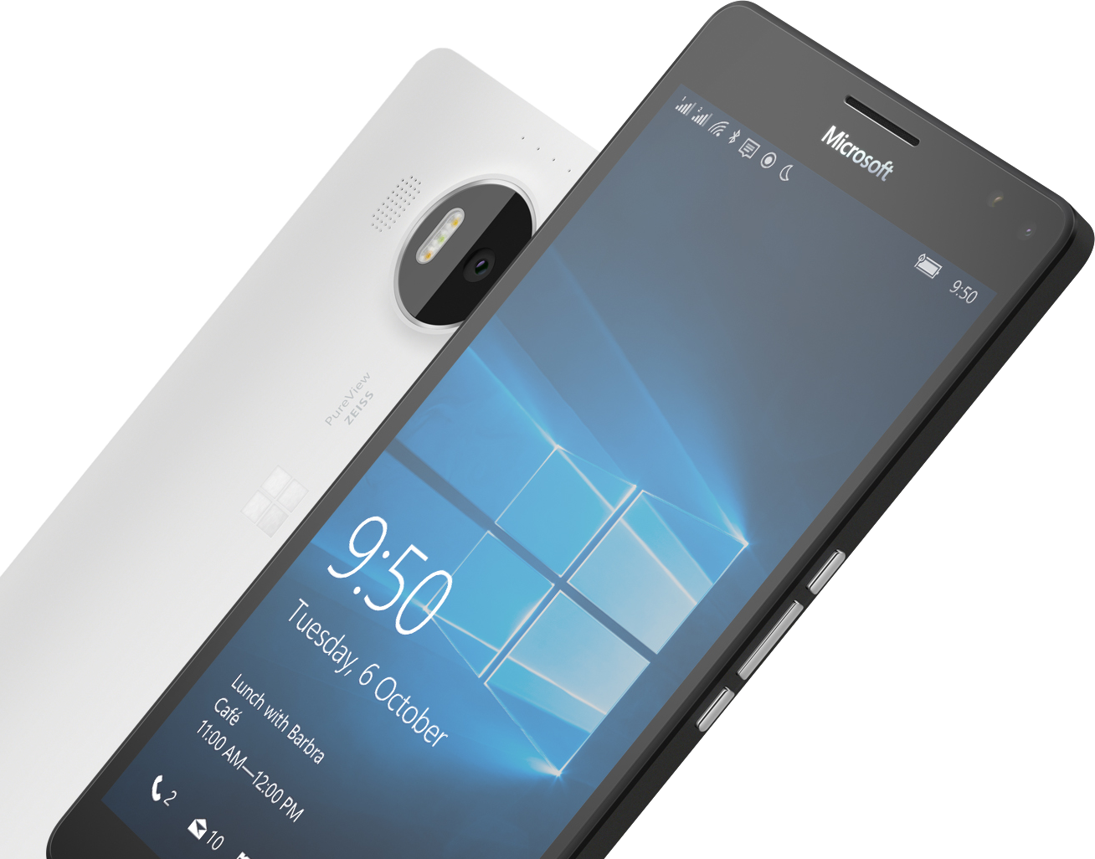
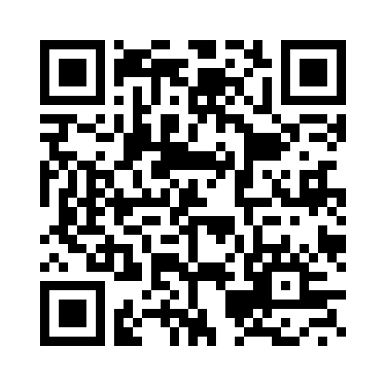
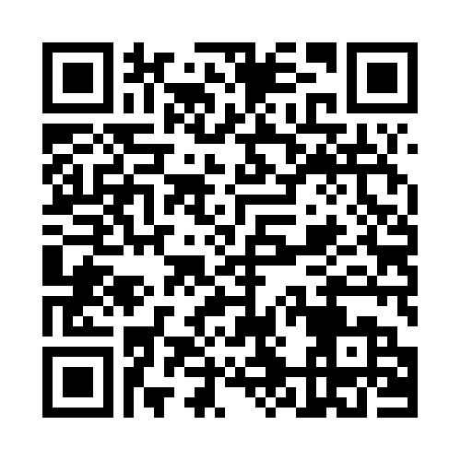

Please Complete An Evaluation Form Your input is important!
SAMPLE
or
Notes:
Update phone image to a Microsoft phone.

Slide 14
Evaluate this session
SAMPLE
Notes:
Speakers: Please note this slide will be updated with your session’s QR code during the scrub process which is outlined on side 3. Attendees can scan the QR code for access to your session’s eval.

